Slide 1
Fuel cell electric vehicles and hydrogen fueling in California
Notes:
Good afternoon. California takes seriously the challenge of reducing carbon emissions to protect the climate, improving air quality to protect public health and diversifying our transportation fuels to reduce petroleum use. The state has adopted strong policies to meet ambitious goals in all three areas, and fuel cell electric vehicles are essential to meeting these goals.
We are making good progress and I’m pleased to have the opportunity to give you some highlights.

Slide 2
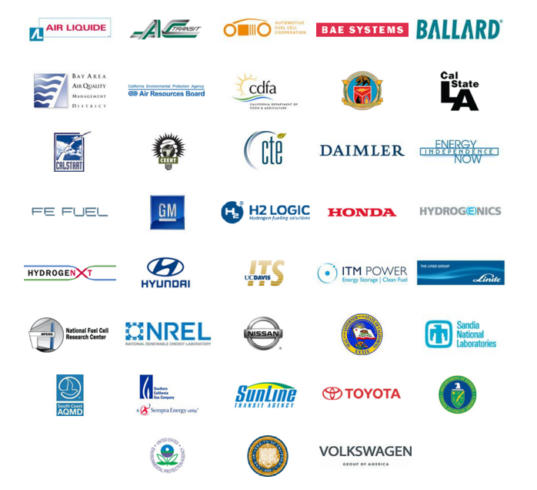
Who we are
Notes:
To take a step back from the technology, I’d like to quickly talk about CaFCP. We are a member organization of automakers, government, energy, infrastructure and related groups all dedicated to the successful commercialization of FCEVs and H2 fueling. Our staff is here with free expertise and experience to support the vehicle deployment and infrastructure development in your community. We have several staff here – CaFCP please raise your hands so we can see you – who are available to help with events and outreach, permit or emergency response education, or general questions… please let us know how we can help you.
I know that was quick, but hopefully it will provide enough of a launching point to dive deeper into the vehicle, infrastructure and other topics we will here this morning. IF we have time I can take questions now, or please ask me or my staff later today – such as at the Ride and Drive!!!
Thank you…

Slide 3
Just to be clear…
EVs come in two flavors
Battery and fuel cell
I am not a scientist nor an engineer
Be gentle when asking questions
I will not engage in EV Death Match
Fuel cells and batteries are not in a fight to the death

Slide 4
California is taking the lead with fuel cell vehicles
 | Funding | For at least 100 H₂ stations through California Energy Commission
 | ZEV Action Plan | Agency actions to enable FCEVs and BEVs
 | ZEV Manager | Governor appointee to help with planning and permitting for H₂ and charging stations
 | State Fire Marshal | Including hydrogen and FCEVs in state training guidelines
 | Weights & Measures | Setting standards for certifying dispensers
 | Evaluation | Survey of OEM deployment plans
Notes:
CA is the launching spot for FCEVs in the US, like so many other new technologies.
In 2012 Governor Brown issued an Exec Order to meet CA’s long term environmental goals, outlining 2015, 2020 and 2025 goals for ZEVs. Since then a ZEV Action Plan, Community Readiness Guidebook and other tools have been developed, with the State continuing to show its commitment, support and leadership for these technologies.
Through the Energy Commission’s solicitation process over 50 retail stations are in various stages of development, including other support mechanisms such as O&M support for station operators during the early years as vehicle deployment grows. CEC has also supported FCEBs, planning tools and activities such as DMS metrology work to enable retail hydrogen sales.

Slide 5
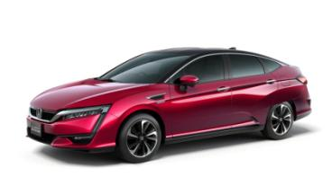
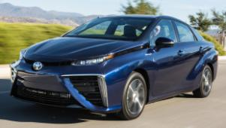
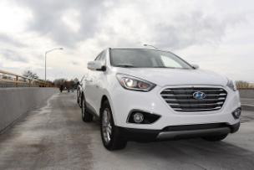
They’re here. And more are coming…
Including GM, Nissan, BMW, Volkswagen, Audi
Notes:
FCEVs are coming to market this year and next. Just last week I met Tim Bush, the State Farm agent and his family who have the first commercial lease of a Tucson Fuel Cell. Also last week SunLine Transit agency took delivery of 2 new all-American fuel cell buses to add to the 2 buses already carrying passengers every day in the Coachella Valley. And one of my staff received an offer to participate in a market survey on FCEVs from Toyota. Yes, its really happening!

Slide 6
Today in California 800+- FCEVs on the road
Hyundai leases the Tucson
Toyota introduced the Mirai in 2015
Honda intros the next-gen Clarity in late 2016/2017
Mercedes-Benz intros the GLC plug-in fuel cell in 2017
More automakers will come to market:
Audi, BMW, Ford, GM, Lexus, Nissan, Volkswagen
4 transit agencies operate 20 buses
AC Transit in East Bay
SunLine Transit in Coachella Valley
UC Irvine and OCTA in Orange County
23 open retail stations (as of 11/10/2016)
50+ stations by end of 2017

Slide 7
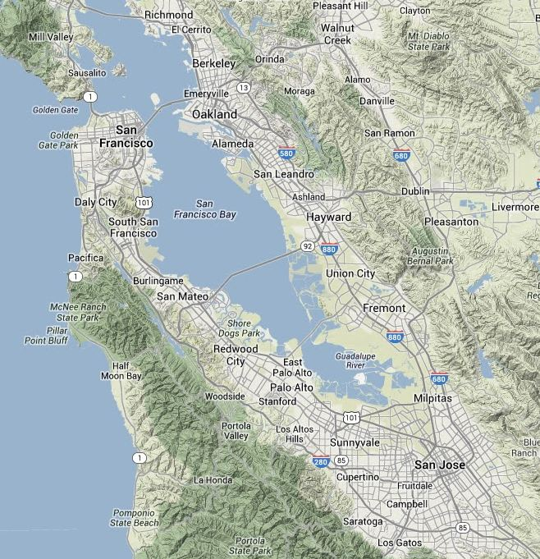
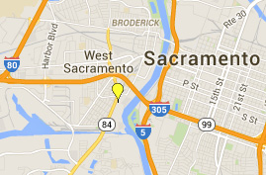
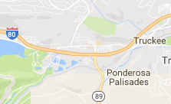
November 2016
Northern CA
Hydrogen Stations
Retail: Open
Campbell
Hayward
Mill Valley
San Jose
Saratoga
South San Francisco
Lake Tahoe-Truckee
West Sacramento
Other: Open
Emeryville – AC Transit
Oakland – AC Transit
Retail: In Development
Fremont
Mountain View
Palo Alto
*Rohnert Park
San Ramon
Woodside
*Not shown on map
California Fuel Cell Partnership
www.cafcp.org/stationmap

Slide 8
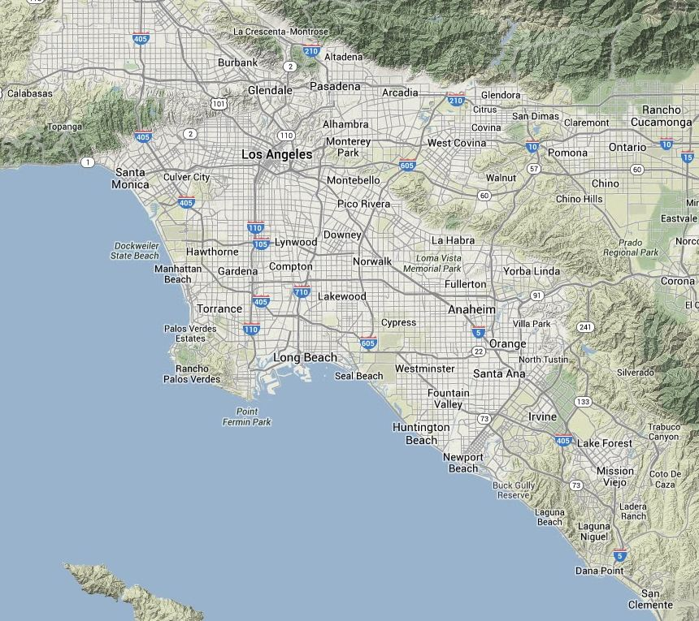
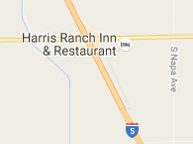
November 2016
Southern CA
Hydrogen Stations
Retail: Open
Costa Mesa
Diamond Bar
Fairfax-LA
Harris Ranch
Hollywood
La Cañada Flintridge
Lake Forest
Long Beach
Playa Del Rey
San Juan Capistrano
*Santa Barbara
Santa Monica
UC Irvine
West LA
Woodland Hills
Other: Open
Burbank
Fountain Valley
Harbor City
Newport Beach
*Thousand Palms – SunLine Transit
Torrance
Retail: In Development
Anaheim
Cal State LA
Chino (upgrade)
*Del Mar
Lawndale
LAX (upgrade)
North Hollywood
Ontario
Orange
Rancho Palos Verdes
*Riverside
South Pasadena
*Thousand Oaks
California Fuel Cell Partnership
www.cafcp.org/stationmap
*Not shown on map

Slide 9
Global launch
Germany
Japan
South Korea
U.S. (California)
U.S. (other states)
Northeast corridor: 12 stations funded by Toyota
8-state MOU regarding zero-emission vehicles in 2014
United Kingdom
Scandinavian countries
Examples
German consortium to build 400 hydrogen stations
Tokyo commits $330 million to showcase at 2020 Olympics
California commits to at least 100 stations
Norway to build 20 more stations
Volkswagen to fund $800 million for BEV and FCEV infrastructure in CA

Slide 10
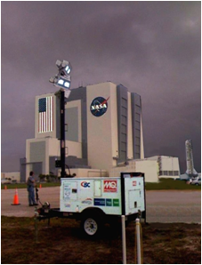
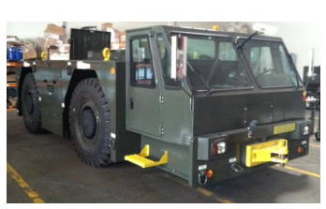
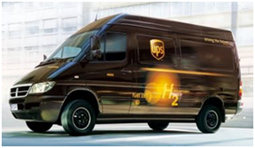
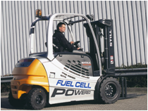
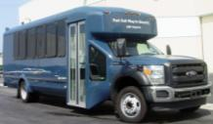
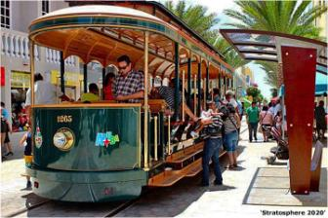
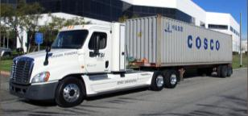
More than cars…

Slide 11
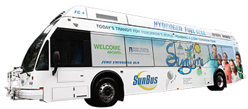
Fuel cell electric buses in California
20 buses in revenue service
Another 30 funded this year
16 years of experience
12 years of federally collected performance data
>2.7M miles in service
>2.5M passengers carried
Buses adopt technology first; pave the way for heavy-duty vehicles.
Notes:
It’s not all about passenger vehicles, however. CA now has 16 fuel cell buses in operation (with 2 more on the way) that cumulatively have driven over 1.5M miles and carried well over 2.5M passengers. Fuel cell buses have proven they are capable replacements for conventional buses. Our bus roadmap published last year lays out the next steps in the commercialization process – two 40-bus centers of excellence with buses fully integrated into normal operations for a 12-year period. CaFCP members and advocates are working to ensure theCA state budget includes funding for these projects, and SunLine Transit has already indicated they aim to become a fuel cell bus center of excellence. Zero-emission heavy- and medium-duty vehicles, from trucks used in ports to package delivery trucks and vocational vehicles, are essential for meeting the state’s clean air goals and CaFCP is now developing a medium- and heavy-duty FCEV roadmap to chart the course for bringing these vehicles closer to commercialization. We expect that roadmap to be published later this year.

Slide 12
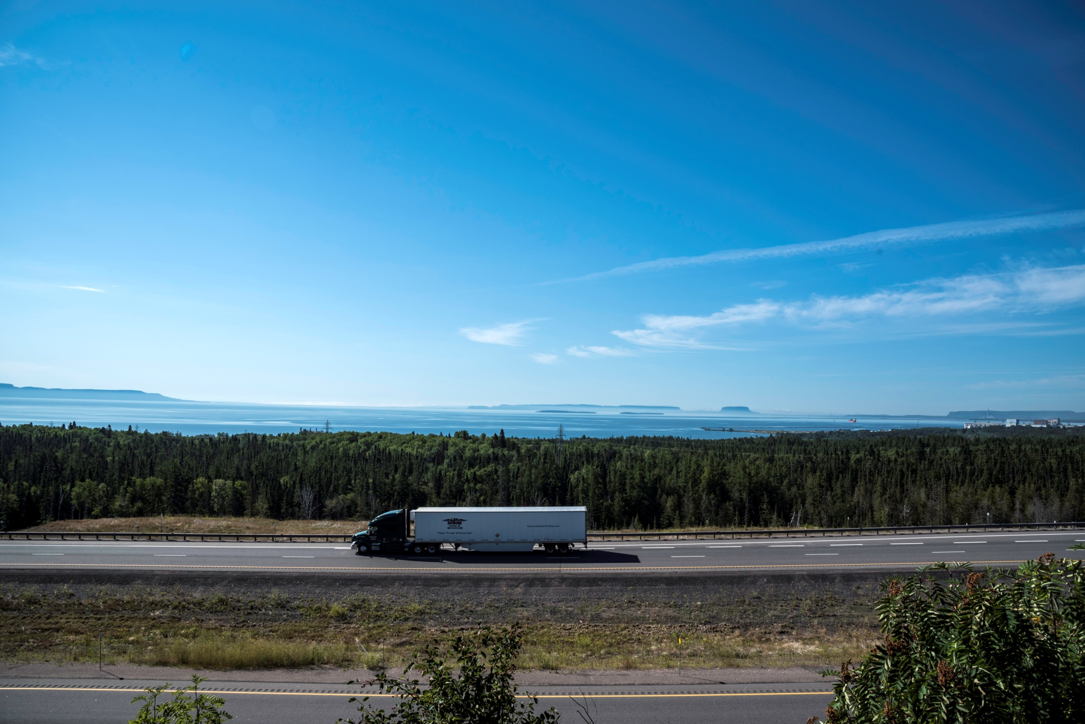
952,000
trucks in California
Notes:
For your context, there are close to one million trucks in California that are mainly running on diesel, and state and federal governments have taken steps to reduce diesel emissions. The end game of this effort, though, is to transition to zero-emission trucks in the same manner that the transition to ZEVs has begun.
The question is … how?

Slide 13
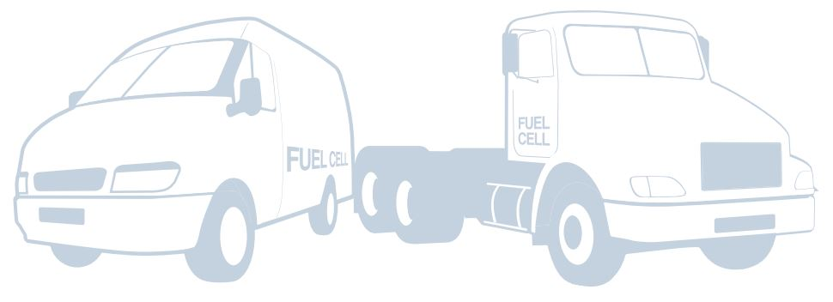
How….
1
Successfully demonstrate fuel cell trucks to spur more development.
2
Establish the necessary hydrogen infrastructure for trucks.
3
Create a sustainable business case for truck manufacturers.
Notes:
The purpose of our action plan is to provide an initial path to answer the “HOW” question. Through research, interviews, and facilitated workshops with truck OEMs, truck integrators, station providers and several other stakeholders, the project team identified three big picture needs. These are not sequential—all have to be done in parallel.
Unlike automakers, truck manufacturers are not required to build, sell, or operate ZEVs. In fact, not many of them are even interested in ZEVs. Some truck OEMs increasingly use electrification of components to improve fuel economy (along with other steps such as more aerodynamic designs).

Slide 14
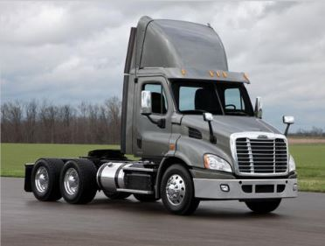
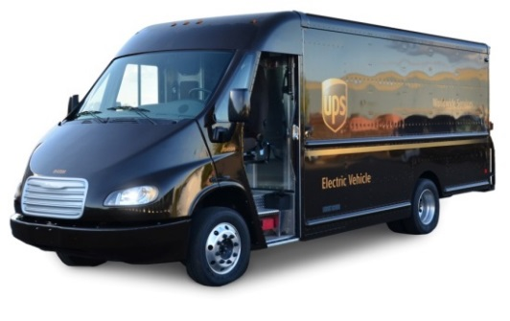
Initial Truck Vocations
Focus on two vehicle platforms and applications
MD FCET platform: Class 4-6 last-mile package delivery trucks
HD FCET platform: Class 7-8 short haul/drayage trucks
Source: CTE
Source: Hydrogenics
Notes:
Our member task force identified two truck vocations for initial demonstration and focus, due to their operational characteristics and immediate air quality benefits for surrounding communities. The demonstrations of trucks in these vocations should occur in the regions most where most trucking activities occur and where air quality issues are most severe.

Slide 15
Demonstrations
Focus on
SCAQMD air basin
San Joaquin Valley
San Francisco Bay Area
Start with truck vocations that return to home base
Use lessons learned from fuel cell buses
Determine metrics that do not change
Notes:
NOTE FOR SPEAKING POINTS—Because you are first to speak, instead of explaining the vocations mention that Mark and Abas are going to cover those two vocations—delivery vans and drayage trucks—in their talks. Use your time to talk about the metrics.
Many of the recommendations in the AP center on collecting data and using a consistent system to measure performance, progress, and success. Therefore, the AP proposed metrics for MD and HD vehicles.

Slide 16
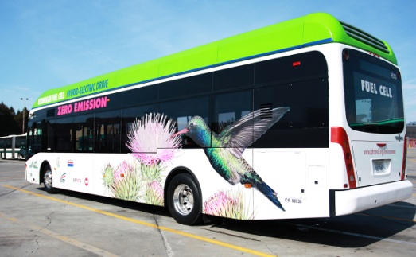
Infrastructure
Trucks use dedicated fueling stations
A small fleet will need more capacity than today’s retail stations
H35 is sufficient pressure for trucks
Lessons learned from fuel cell bus fueling transfer to trucking
Notes:
Within our group, we already understand the importance of needing hydrogen stations slightly before vehicles, but that isn’t well understood with new stakeholders. We will need to make the case for capital and O&M funding for heavy-duty stations in addition to the build out of retail hydrogen stations.
It’s also important that we think about areas where MD and HD vehicles could use existing hydrogen stations. The Ramos Oil station in West Sac was originally a truck-only station. Although an island of pumps sells fuels to passenger cars, the station itself has high canopies and wide driveways that make it easy for trucks to pull in and out. (It also has high-pressure air designed for truck tires, as one of our staff discovered when she overinflated her car tire in about 2 seconds.)

Slide 17
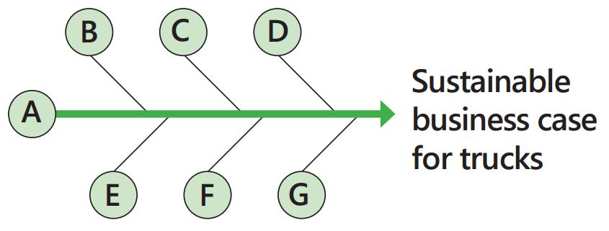
Sustainable business case
Meets customer requirements
Favorable operating environment
Regulatory stability for product planning
OEM “essentials”
Essential enablers
Revenue to sustain operations
Return on investment + profit
Incentives support the path to sustainable sales
Reliable, accessible, and affordable fueling
Go/no-go milestones
Some truck vocations may never transition to ZEVs
Provide time for iterations to meet minimum requirements
The bottom line assumption is that the TCO should be competitive with conventional technology
Notes:
The truck OEMs who participated in the project identified these 7 major components as necessary for a sustainable business case. I want to emphasize that like all companies with new technology, the OEMs don’t expect these on day 1.
To achieve these, our industry must build a better understanding of the truck market, just as CaFCP built with gas station owners to advance retail hydrogen stations. The workshops conducted for the action plan were a good step, but only a first step.
Government may need to assess options for developing a ZEV credit or long-term incentive strategy for MD and HD ZEVs to encourage truck integrators and OEMs to invest in the RD&D of fuel cell technology in trucks
Chris’ content:
Meets customer cost and operational requirements, including ability to get financing and ability to plan for fleet purchasing
Favorable operating environment, including broad industry support of technology (including manufacturers and suppliers)
Supportive and consistent legislative and regulatory framework
OEM “essentials,” including the ability to leverage existing manufacturing lines and components, a line of sight to volume sales, and revenue to sustain operations during a demonstration program
Incentives that match the development schedule, such as manufacturing incentives in the beginning and customer incentives later on
Reliable, accessible, and affordable fueling
Go/no-go milestones that identify some trucks that may never transition to ZEVs and provide time for iterations to meet minimum requirements.

Slide 18
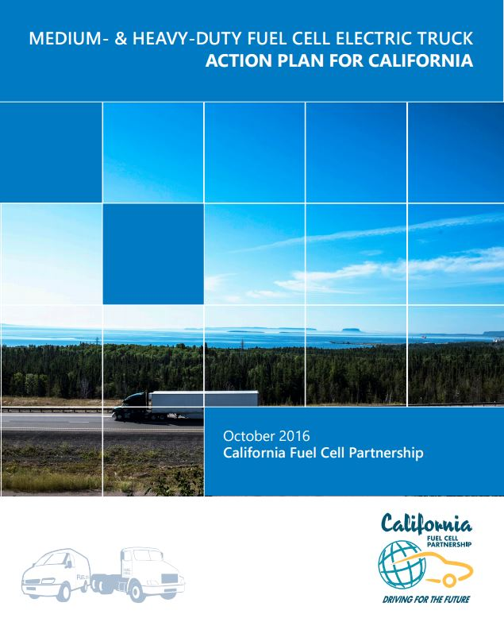
Four Focus Areas
Initiating funded FCET demonstration projects
Accelerating demonstration of FCEV technology in MD package delivery and HD short-haul trucks
Developing permanent hydrogen fueling infrastructure for California’s FCET demonstration projects
Continue discussion and expand public-private partnerships
cafcp.org/buses_trucks
Notes:
The action plan’s recommendations focus on four main areas. I’ve shared with you the priority recommendations, and you’ll find several others listed in the action plan as well. The complete plan and a summary version are available for download on the Buses and Trucks page of the CaFCP website.

Slide 19
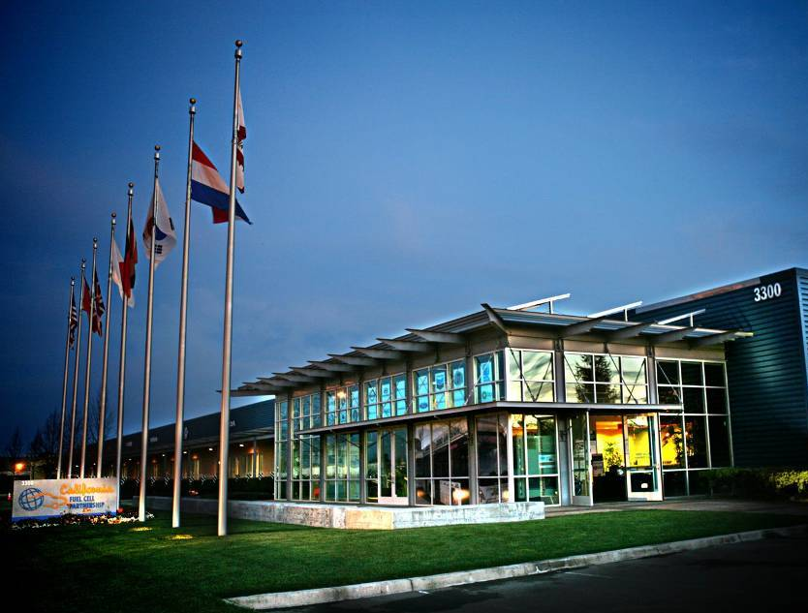
Keith Malone
kmalone@cafcp.org
www.cafcp.org
Follow us on Facebook, Twitter and LinkedIn
#fuelcell #driveH2

Slide 20
Hydrogen is on a renewable pathway Like electricity
SB 1505 – 33% renewable hydrogen
Splitting water using wind or solar power
Excess capacity on grid gives us an opportunity
Tri-generation fuel cells
Pioneered at UC Irvine
3-yr demonstration at OC Sanitation District
Low carbon footprint

Slide 21
How a fuel cell works
Notes:
I know show you a video on, “how a fuel cell works”.

Slide 22
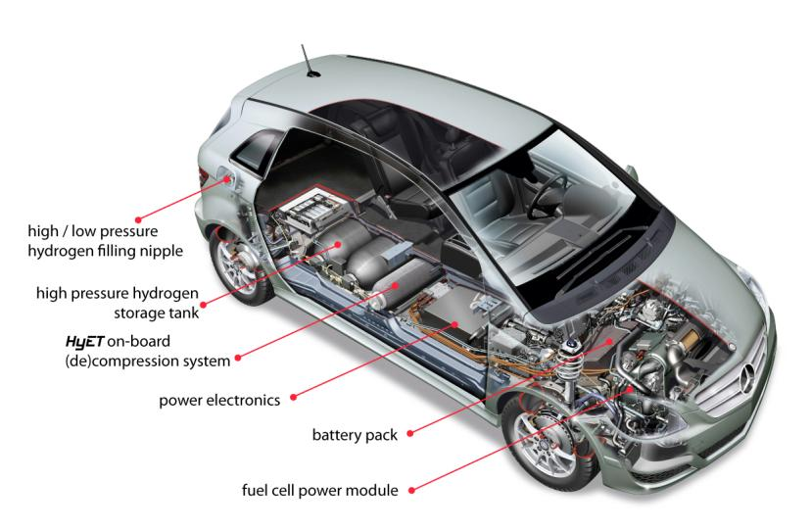
FCEVs are electric vehicles
Fuel cell stack
Notes:
The most important thing to know about FCEVs is that they are electric vehicles and have zero tailpipe emissions. FCEVs are an essential part of automakers’ portfolio of electric drive vehicles and enable them to electrify larger, longer-range full-function vehicles.
Many of the components of FCEVs are the same as plug-in Evs - electric motors, controllers, even batteries. But instead of plugging in, FCEVs are refueled with hydrogen at a fuel station, much as we refill our cars today. It takes 5 minutes and a full tank will take you 250 – 400 miles.

